Slide 1
Selecting Documents Using Comparison Query Operators

Slide 2
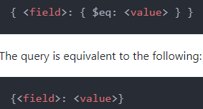
MongoDB $eq operator
The $eq operator is a comparison query operator that allows you to match documents where the value of a field equals a specified value.
The following shows the syntax of $eq operator

Slide 3
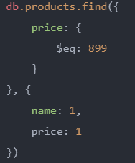
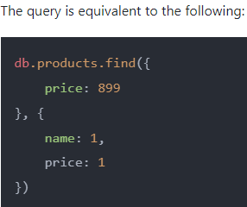
Using $eq operator to check if a field equals a specified value
The following example uses the $eq operator to query the products collection to select all documents where the value of the price field equals 899

Slide 4
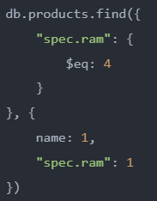
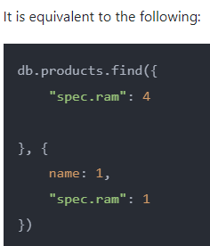
Using the $eq operator to check if a field in an embedded document equals a value
The following example uses the $eq operator to search for documents where the value of the ram field in the spec document equals 4

Slide 5
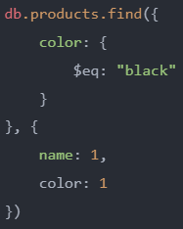
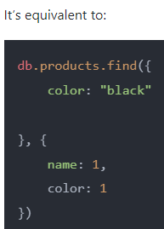
Using $eq operator to check if an array element equals a value
The following example uses the $eq operator to query the products collection to find all documents where the array color contains an element with the value "black“

Slide 6
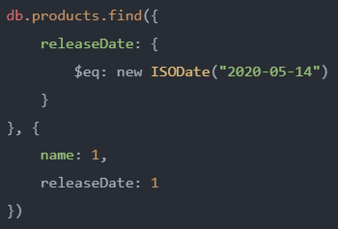
Using $eq operator to check if a field equals a date
The following example uses the $eq operator to select documents in the widget collection with the published date is 2020-05-14

Slide 7

MongoDB $gt operator
The $gt operator is a comparison query operator that allows you to select documents where the value of a field is greater than (>) a specified value.
The following shows the syntax of the $gt operator

Slide 8
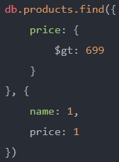
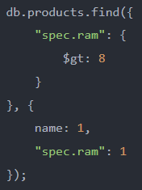
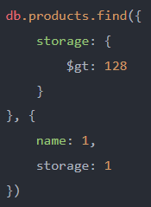
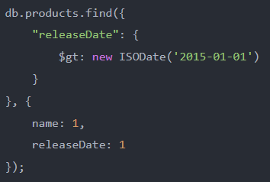
MongoDB $gt operator - Examples

Slide 9

MongoDB $gte operator
The $gte is a comparison query operator that allows you to select documents where a value of a field is greater than or equal to ( i.e. >=) a specified value.
The $gte operator has the following syntax

Slide 10
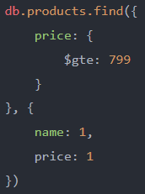
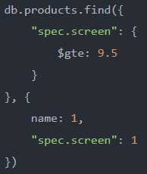
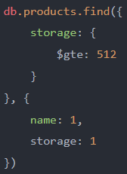
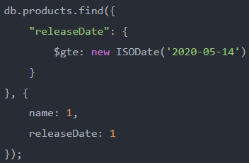
MongoDB $gte operator - Examples

Slide 11

MongoDB $lt operator
The $lt operator is a comparison query operator that allows you to select the documents where the value of a field is less than a specified value.
Here is the syntax of the $lt operator:

Slide 12
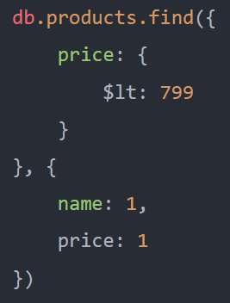
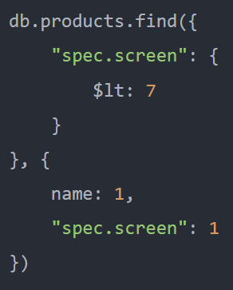
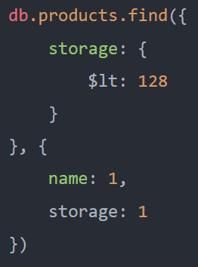
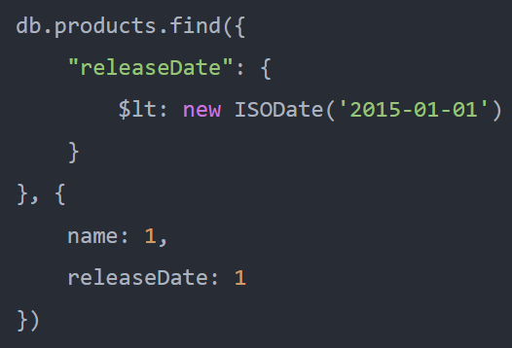
MongoDB $lt operator - Examples

Slide 13

MongoDB $lte operator
The $lte is a comparison query operator that allows you to select documents where the value of a field is less than or equal to ( <= ) a specified value.
The following shows the $lte syntax

Slide 14
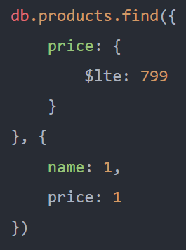
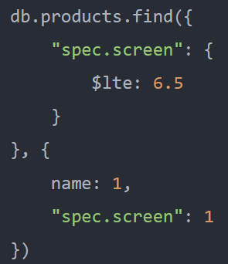
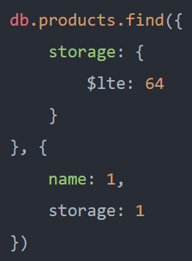
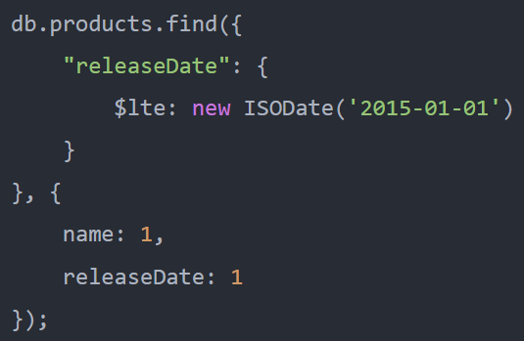
MongoDB $lte operator – Examples

Slide 15

MongoDB $ne operator
The $ne is a comparison query operator that allows you to select documents where the value of a filed is not equal to a specified value.
It also includes documents that don’t contain the field.
The $ne is called the inequality operator.
Here is the syntax of the $ne operator:

Slide 16
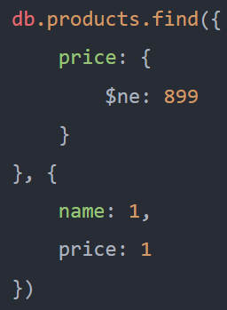
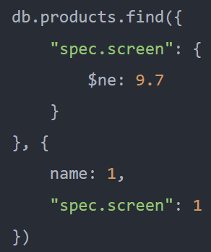
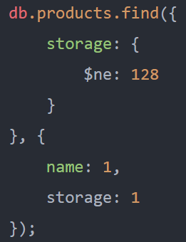
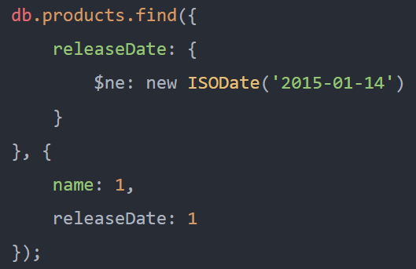
MongoDB $ne operator - Examples

Slide 17
MongoDB $in operator
The $in is a comparison query operator that allows you to select documents where the value of a field is equal to any value in an array.
The following shows the syntax of the $in operator

Slide 18
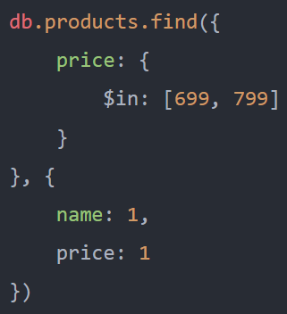
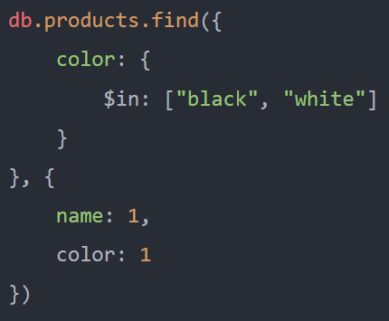
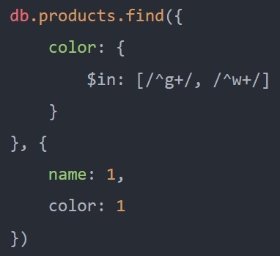
MongoDB $in operator - Example
The following query uses the $in operator to find documents where the color array has at least one element that matches either /^g+/ or /^w+/ regular expression

Slide 19
MongoDB $nin operator
The $nin is a query comparison operator that allows you to find documents where:
the value of the field is not equal to any value in an array
or the field does not exist.
Here is the syntax of the $nin operator

Slide 20
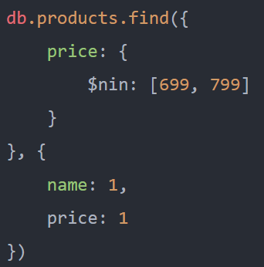
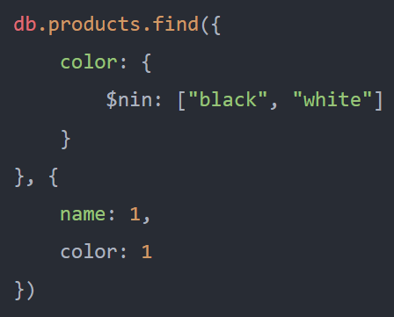
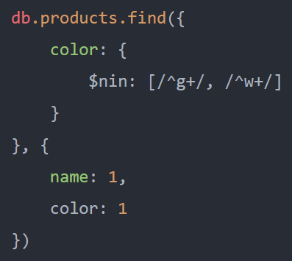
MongoDB $nin operator - Example
The following query uses the $nin operator to find documents where the color array doesn’t have an element that matches /^g+/ and /^w+/ regular expression

